Slide 1
Clinical Sciences Building Move Team Kick-Off
April 25, 3:30-4:30 p.m.
April 29, 10:00 – 11:00 a.m.
May 8, 10:00 – 11:00 a.m.

Slide 2
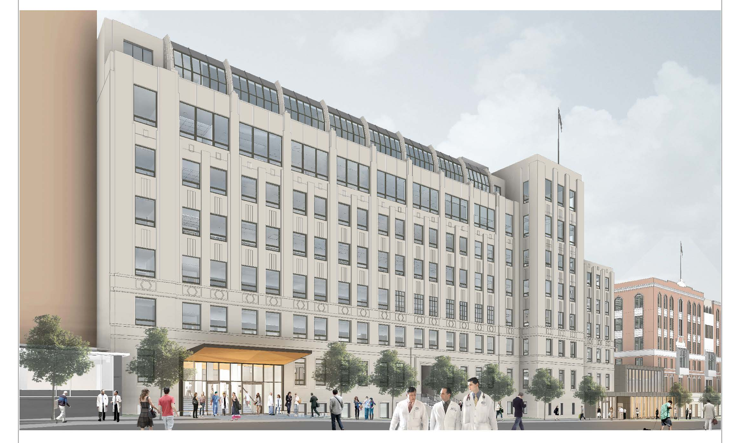
Agenda
Introductions
Timeline
Clinical Sciences Building Update
Move Logistics
Document Management
Change Management
Resources
Wrap Up & Next steps

Slide 3
Introductions & Roles
MHS – Move Coordination Company
Eric Larsen – Project Manager
James Layton – Document Management
Cristina Morrison – Change Management
Caitlin Snow – APEX Liaison
Robert Szoke – Information Technology Services
Luis Vite – Change Management & Operations
Debra Roche – Project Manager
Notes:
Short introduction of what we are each taking charge of – whoever is in attendance can speak to their roles.

Slide 4
Draft Clinical Sciences Building (CSB) Change Management & Move Planning Timeline
Change management
Activation of Move Team
Move Logistics
Target: Feb 15
Move Logistics Instructional Town Hall Meeting #2
Telephone & IT Device Detail on Move Matrix Deadline
Mar - Apr
Dec ##
Move Phases
Draft Document Management Project Plan and Estimate Forms
Move Logistics Instructional Town Hall Meeting #1
Mar 15
Sept ##
Nov 7
Seat Assignments on Move Matrix Deadline
Building Town Hall Meeting #1
Building Town Hall Meeting #2
Dec 20
Aug ##
Oct ##
Mar – Apr
Jan
6 days
Feb
Today
Mar
Apr
May
Jun
Jul
Aug
Sept
Oct
Nov
Dec
Jan
Feb
Mar
Apr
May
2019
18 days
24 days
2020
Feb-Mar
Jun - Aug
16 days
Change Management Activities for Open Plan Shared Resources
Formation and Activation of Bldg Gov Committees
Jan - Mar
25 days
Q1 2020 Phase 2 Move-in
March
Jul – Oct
Apr
Current Site Prelim Surveys
& Jobwalk Tours for Move Companies
Transition Planning for Daily Operations
Move-in Support
& Follow Up
Feb – Aug
Document Management Strategies for Moving to Paper-Lite

Slide 5
Clinical Sciences Building Update
Holly Smith Gateway to Saunders Court
Expected completion late Q4 2019
Expected move-in Q1 2020
Lactation room on Level 5
Wellness Rooms on Levels 3 and 7
Educational Technology Services on Sub-Level and First Floor with state of the art classrooms and multi-function rooms
Gender neutral bathrooms on Levels 2, 4 and 6
Notes:
Mini conference center will be managed by CLS; details on scheduling and access will be provided in the coming months.
The hotel hub on the third floor will have day lockers and a variety of seating areas for touch down space.

Slide 6
Who is in the building?
Facilities Services
Executive Vice Chancellor & Provost
School of Dentistry
School of Medicine
School of Pharmacy
School of Nursing
The Clinical Sciences Building, constructed in 1933, is one of the oldest buildings on the Parnassus Heights campus. The building is being renovated and retrofit to meet seismic safety requirements

Slide 7
Move Logistics: Pre-Planning Activities
Receive updated construction schedule
Develop rough move phase outline
Develop draft furniture installation schedule – by floor
Receive and evaluate move matrix for department and division head counts
Receive office storage plan for items moving to new building
Prepare move company bid documents and bid tour schedule

Slide 8
Move Logistics: Planning
Develop preliminary action items from move
meetings
Update move matrix for duration of planning stages
Develop individualized move meeting schedule and presentation content in concert with change agents
Create and distribute general move guide instructions
Create and distribute detailed logistic move schedule

Slide 9
Move Logistics: FAQ
How many days can I expect my department or division to shut down for the move?
What items can I bring?
Is my phone moving with me?
Who is managing desktops, monitors and computer moves?
What about my laptop?
Once a move date is confirmed, how much time will I have to pack?
How many boxes can I bring to my new work space?

Slide 10
Document Management – Paper-Lite
Why change to a paper-lite workspace?
Use onsite space for people not paper
Support UCSF sustainability goals
Information is available whenever you need it, wherever you are

Slide 11
Document Management – UC RRS
Where can I find out how long to keep records?
UC Records Retention Schedule (UC RRS)
UC RRS Webinar
Administrative Records Relating to Research: Retention and Disposition Requirements
Record Retention Schedule Snapshot with most common record categories available to simplify determining how long to keep a record

Slide 12
Document Management – Options
Scan
In-house
Vendor
Store
Offsite Vendor
Onsite (minimize volume)
Move to UCSF Archives
Dispose
Shred
Recycle
Delete

Slide 13
Document Management – Act now
Change Agents and Managers are managing the process
Assess current state
Do you have paper documents? Do you have kits or other materials that need storage?
Plan for processing paper and electronic records
Plan for budget, staff time and tools
Paper can be stored off-site, digitized (scanned) or shredded
Review books and journals; be selective
Determine retention schedules and dispose appropriately
Review what is left and determine storage needs
Plan to complete by at least a month before your move date
Need assistance/ guidance? James Layton – Digital Project Manager (James.Layton@ucsf.edu)

Slide 14
Change Management Overview
Change Agents
Open Plan at UCSF – a new way to work
Shared resources – storage, kitchen, focus and huddle rooms
Building and Floor governance
Getting to know my floor & building colleagues

Slide 15
Change Agents
Inform
Inspire
Influence
Trusted department or division source of information
Lead by example and demonstrate desired behaviors
Identify types of resources needed to support staff and faculty on their team
Partners with Cristina Morrison, Leon Gardiner and other move team members throughout the process.
Engage with and inform department leadership throughout the process.
Engages with change agents on the floor and building to share best practices

Slide 16
Change Agents
Inform
Inspire
Influence
Executive Vice Chancellor & Provost: Suzanne Murphy, Winona Ward, Mae Moredo, Nina Mayo
School of Dentistry : Holly Ames, Brian Bast, Stephanie Louie, Marina Stewart,
School of Nursing: David Rein
School of Pharmacy: Karen Hamblett, Michael Nordberg
School of Medicine
Anesthesia: Robert Hendricks, Linda Liu
Dean’s Office, Academy of Medical Educators: Allison Savage
Dean’s Office, Admissions: Hallen Chung

Slide 17
Change Agents
Inform
Inspire
Influence
School of Medicine
Dean’s Office: Pathways and Medical Education: Allison Savage
Emergency Medicine: Christine Montgomery, Eve Dinh, Steve Polevoi
Department of Medicine: Alyssa Tecklenburg
Cardiology: Alyse Miluck
Endocrinology: Tony Barlow, Umesh Mashrani
Gastroenterology: Annamaria Flamburis
Hospital Medicine: Annie Droste, Brad Sharpe
Palliative Medicine: Angela Marks
Pulmonary: Clarice Estrada, Dean Sheppard
Rheumatology: Tony Barlow, Lindsey Criswell

Slide 18
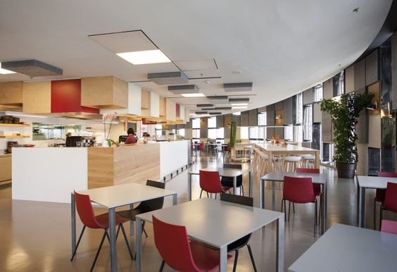
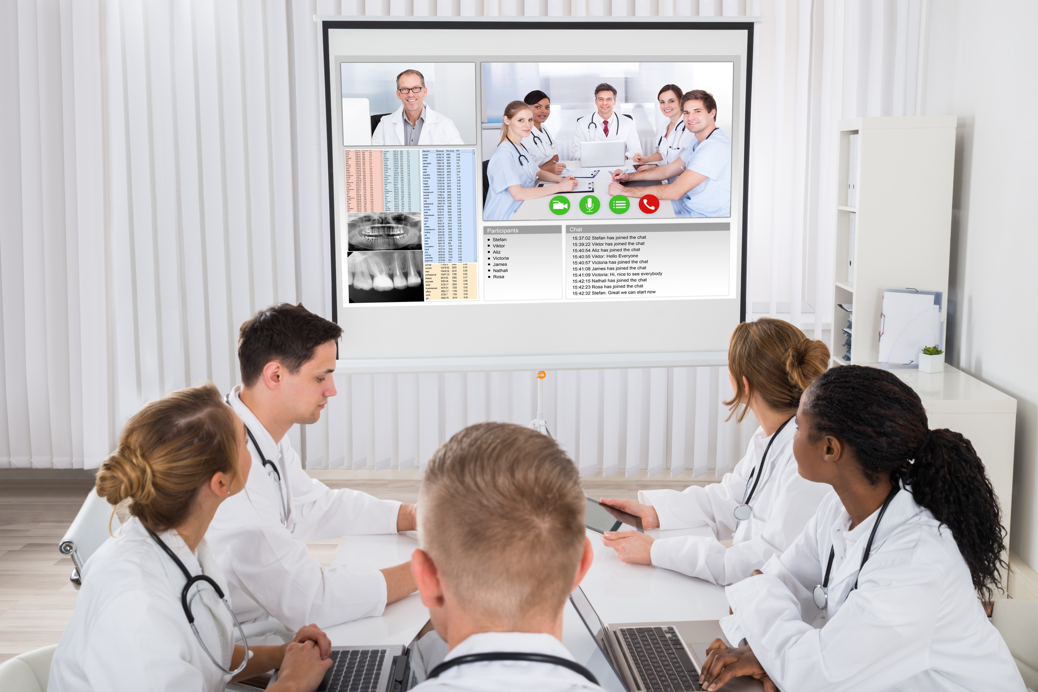
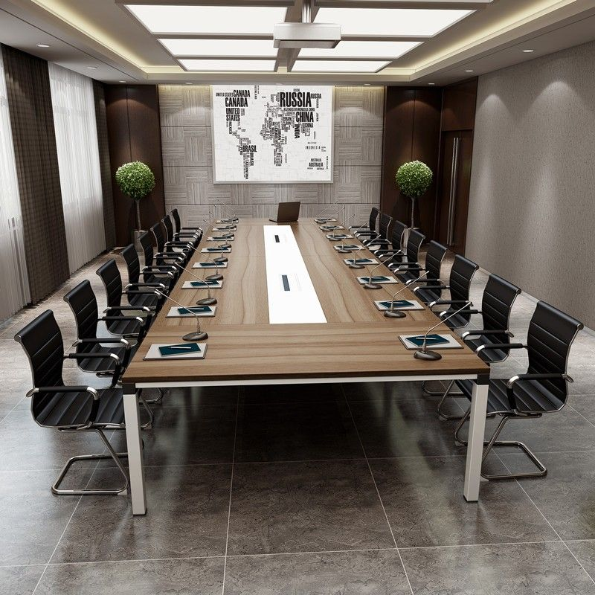
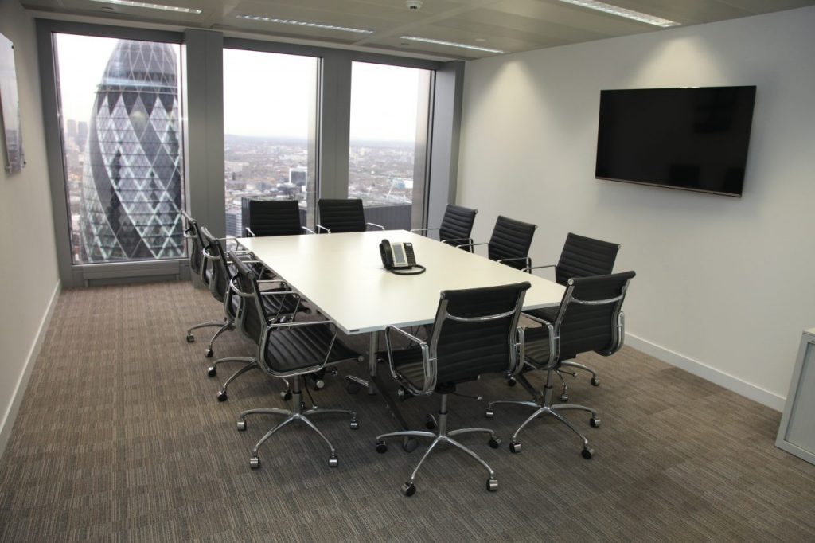
Open Plan at UCSF
Workstation
Private office
Focus room
Hotel Desk
Suitable for one person
Touch down space to use between meetings
Kitchen and break room
Huddle room
Conference rooms
Notes:
Please note the images depicted here are a sample of what a workspace may feel like, and is in no way a depiction of actual spaces in Clinical Sciences or Center for Vision Neuroscience.
Work stations along windows to support natural light for all.
Private offices to be assigned my department leadership
Shared focus rooms to be used to floor occupants
Shared huddle rooms for floor occupants
Conference rooms, storage rooms and kitchens

Slide 19
Building and Floor Governance
Inform
Inspire
Influence
Building Governance Committee to be appointed by control point
Dean’s Office level representation
Floor working group began work in January and will continue through move in
Decisions for the building and floor committees to be made include:
Conference room scheduling and access for all occupants
Print Management for the building
Shared resources (e.g. Floor Coordinator, shared space maintenance)
Building security and access
Notes:
Coffee and tea service will be a shared cost for the floor TBD.
Floor and Building Governance will launch in February; decisions on security, access, and conference room scheduling will be decided for the building by occupant groups.

Slide 20
Typical Floor Plan Levels 2-5

Slide 21
Shared Spaces by Floor
 | Focus | Huddle | Small Conference | Storage | Break-out & Printer | Printer
Floor 2 | 12 | 4 | 1 | 1 | 1 | 1
Floor 3 | 10 | 3 | 1 | 2 | 1 | 1
Floor 4 | 10 | 4 | 1 | 1 | 1 | 1
Floor 5 | 10 | 4 | 1 | 2 | 1 | 1
Floor 6 | 9 | 4 | 1 | 0 | 1 | 1
Floor 7 | 9 | 4 | 0 | 1 | 1 | 1

Slide 22
Floor Amenities
Inform
Inspire
Influence
Shared kitchens with microwaves, refrigerators, and filtered water
Shared conference rooms on Floors 2-6
ITS will provide the specs for technology in the rooms; training will be offered before and after move in
Limited shared storage on all floors except 6
Notes:
Conference rooms on Floor 4 – 2 medium for 20-25 people, 3 huddle rooms, 5 focus rooms
Conference room on Floor 5 – 1 medium for 20 people, 1 huddle room, 4 focus rooms
Floor 6 – 1 medium for 20 people, 2 small conference rooms for 10-12, 3 huddle rooms, 6 focus rooms

Slide 23
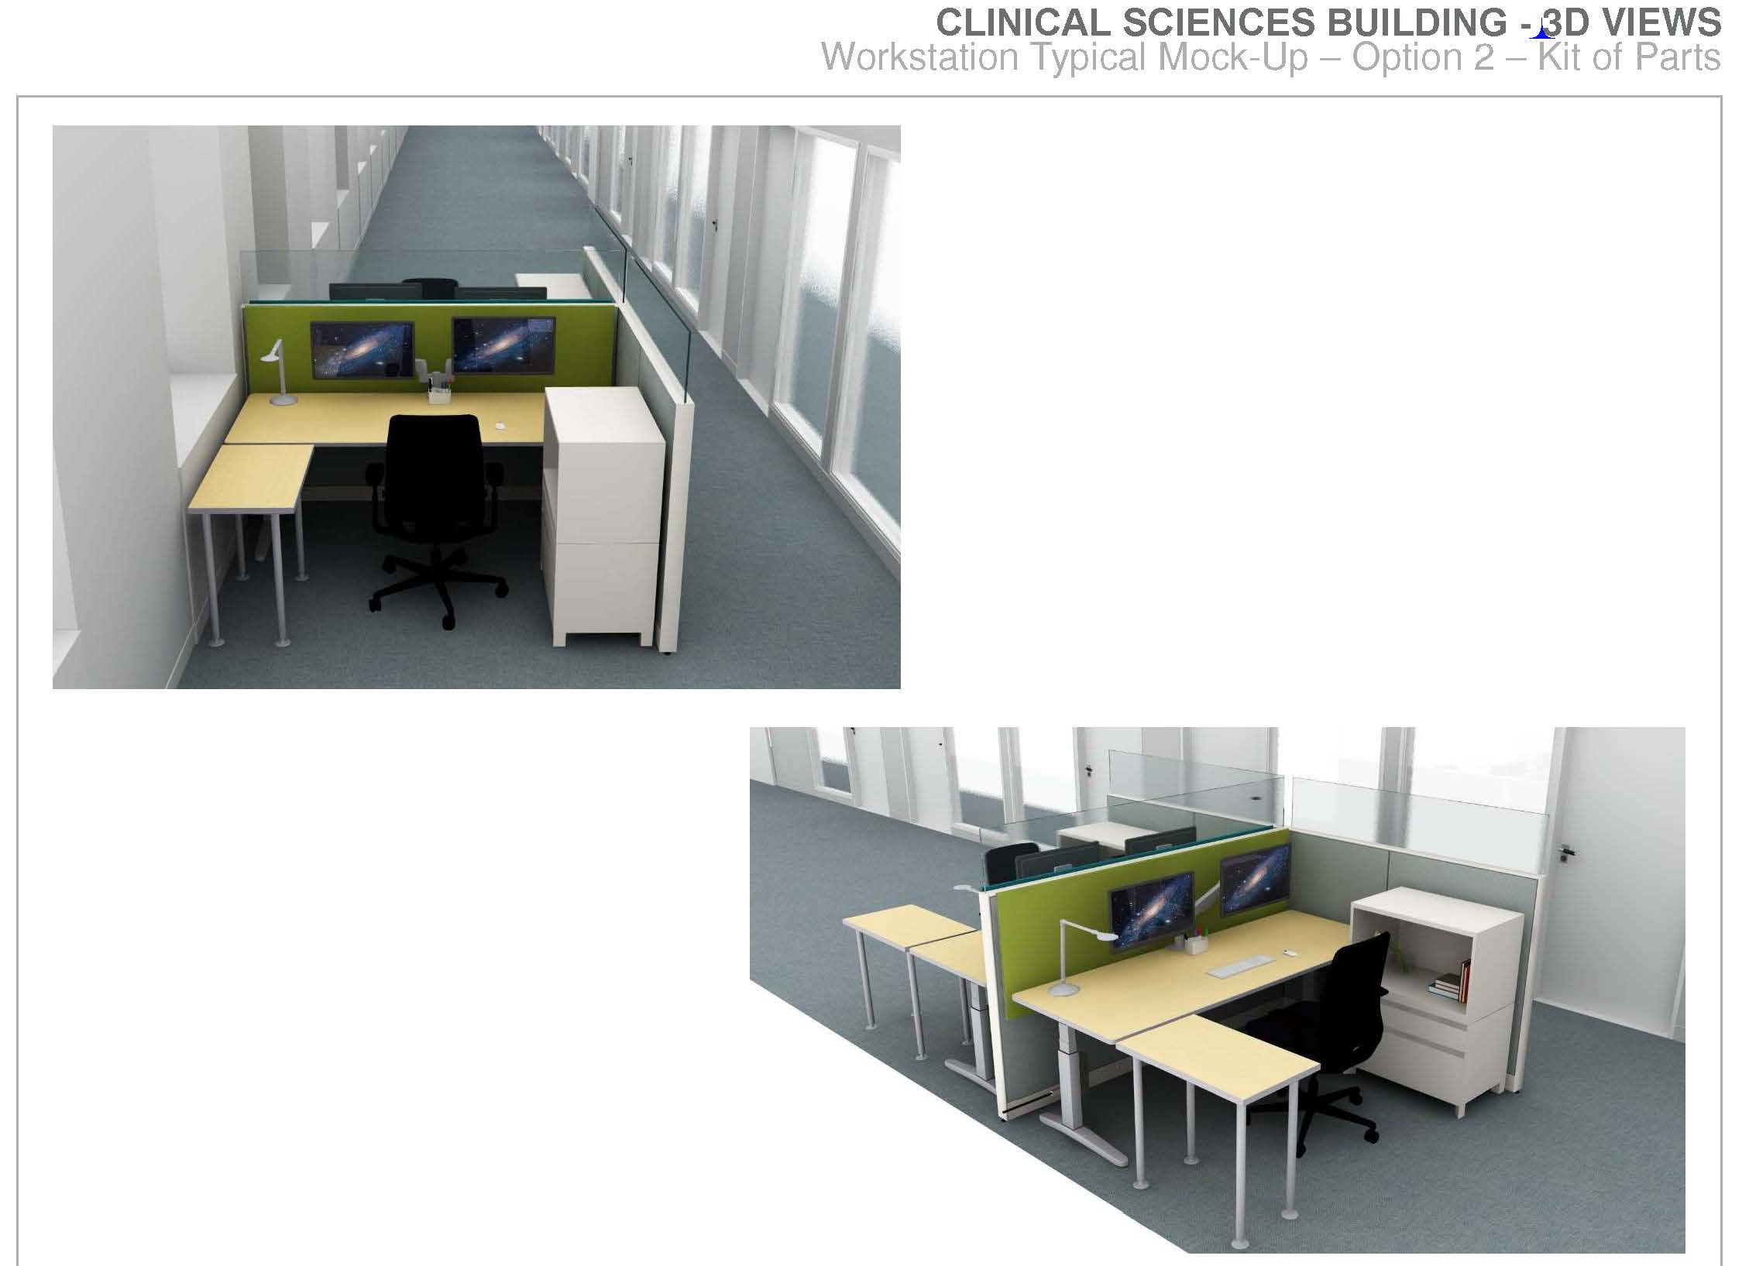
Furniture Kit of Parts

Slide 24
Standard Workstation
Solid partition 48” with 12” clear glad for total partition height: 60”
Clear glass partition
Height adjustable desk
Ergonomic chair
One monitor arm
One lockable storage
Notes:
Conference rooms on Floor 4 – 2 medium for 20-25 people, 3 huddle rooms, 5 focus rooms
Conference room on Floor 5 – 1 medium for 20 people, 1 huddle room, 4 focus rooms
Floor 6 – 1 medium for 20 people, 2 small conference rooms for 10-12, 3 huddle rooms, 6 focus rooms

Slide 25
Typical Private Office Furnishings
Notes:
Conference rooms on Floor 4 – 2 medium for 20-25 people, 3 huddle rooms, 5 focus rooms
Conference room on Floor 5 – 1 medium for 20 people, 1 huddle room, 4 focus rooms
Floor 6 – 1 medium for 20 people, 2 small conference rooms for 10-12, 3 huddle rooms, 6 focus rooms

Slide 26
Frequently Asked Questions
How will noise be mitigated?
How will visitors find me?
Where can I find updates on the building and moving?
What about HIPAA compliance? UCSF Privacy Office and privacy handbook – review the handbook to ensure protected information is handled appropriately - https://ucsf.app.box.com/v/PrivacyHandbook2017
Remember to connect with your change agent for updates and support throughout the move process.

Slide 27
Lessons Learned from Mission Hall
Inform
Inspire
Influence
Include private offices in open plan design
Appropriate ratio of workstations to focus rooms
Isolate common areas to reduce noise impact in work areas
Provided change management support
Include adjustable height work stations
Adopt robust communications throughout the project
Appoint governance committees comprised of occupant groups to make decisions prior to moving in

Slide 28
What Success Looks Like
Inform
Inspire
Influence
Employees are equipped to begin working on day one.
Employees want to work in the new space and understand the benefits of working in open plan environments.
Employees understand etiquette and culture of open plan.
Employees feel supported and heard throughout the transition by managers, change agents, move team and leadership.
Employees adapt to open plan work space and utilize amenities at Mission Bay.
Employees know the community on their floor, understand how to use technology and conference rooms and feel they can get their job done.

Slide 29
Resources and Information
Inform
Inspire
Influence
Clinical Sciences Building website: https://csb.ucsf.edu
Clinical Sciences Building Chatter Group via MyAccess
Space website: https://space.ucsf.edu
Paper-Lite: https://space.ucsf.edu/records-information-management
UCSF Transportation website & my commute
Campus Life Services: Facilities Services Guide September 2017
*See high occupancy buildings on page 23

Slide 30
Wrap up & Next Steps
Inform
Inspire
Influence
Ongoing document management strategies
Department and Division move meetings
Building and Floor Governance decisions
Occupant engagement
Move Matrix
Ongoing updates on website, e-mail, e-newsletter
Thank You!

