Slide 1
Clinical Sciences Building
Move Town Hall
December 5, 2019
3 – 4:30 p.m.
N-729 and Zoom

Slide 2
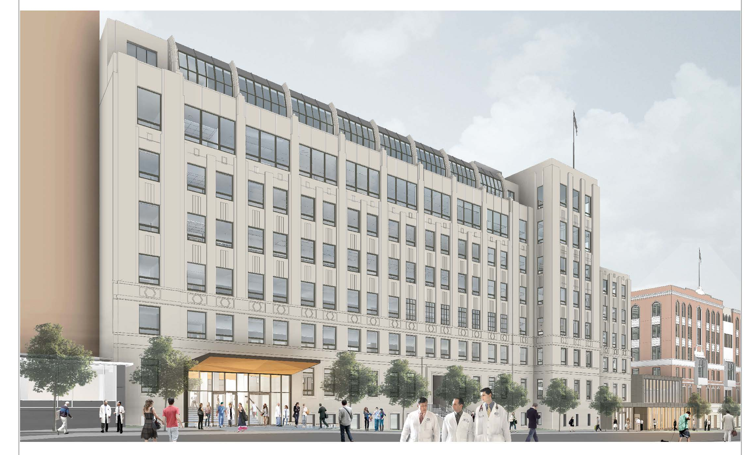
Agenda
Introductions
Timeline
Clinical Sciences Building Update
Change Management
Document Management
Move Logistics
Resources
Wrap Up & Next steps

Slide 3
Introductions & Roles
Leon Gardner – Move Coordinator, MHS
Cristina Morrison – Change Management
Debra Roche – Project Manager
Caitlin Snow – APEX Liaison
Michael Groff – Information Technology Services
Carolyn Tuft – Document Management
Luis Vite – Change Management
Notes:
Short introduction of what we are each taking charge of – whoever is in attendance can speak to their roles.

Slide 4
Draft Clinical Sciences Building (CSB)
Change Management & Move Planning Timeline
Change management
Move Logistics
Telephone & IT Device Detail on Move Matrix Deadline
Move Logistics Instructional Town Hall Meeting #2
Late Feb
(30 days before move)
Move Dates
Nov – Dec
Move Logistics Instructional Town Hall Meeting #1
Late Jan
(60 days before move)
Building Town Hall Meeting #1
Building Town Hall Meeting #2
Nov 7
Jan-Feb
Dec 20
Dec 5
6 days
Today
Dec
Jan
Mar
Apr
May
Jun
Jul
Aug
Oct
Nov
Feb
2019
18 days
2020
24 days
Move Dates
Document Management Strategies for Moving to Paper-Lite (Oct-Feb)
16 days
25 days
Building-wide storage assessment (Nov-Feb)
Change Management Activities for Open Plan Shared Resources
Move-in Support
& Follow Up
Current Site Prelim Surveys & Jobwalk Tours for Move Companies (Nov-Jan)
Develop move matrix for all occupant groups

Slide 5
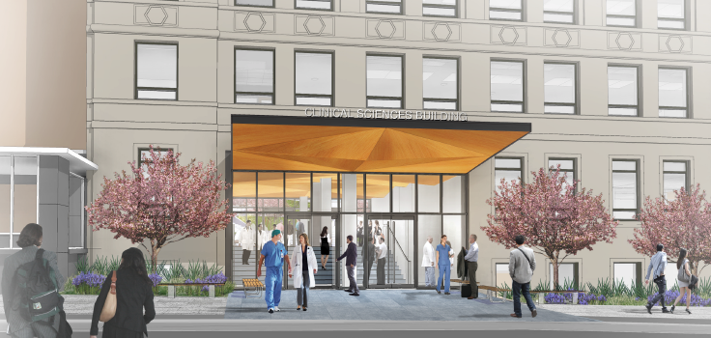
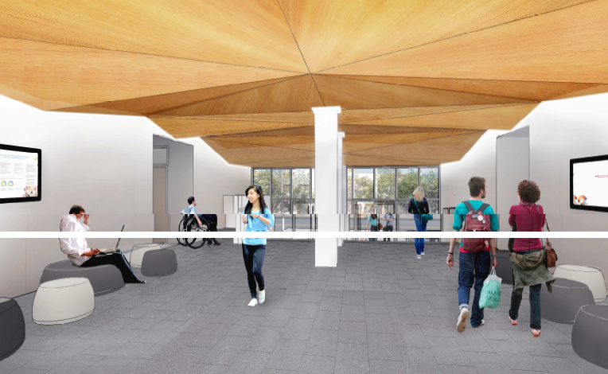
Clinical Sciences Building Update (521 Parnassus Ave)
Expected completion Late Q1 2020
Expected move in Early Q2 2020 (April-May)
Final Space Allocations will be made no later than December 31, 2019
East Entrance Holly Smith Gateway – 1st Floor
Holly Smith Gateway as seen from Saunders Court

Slide 6
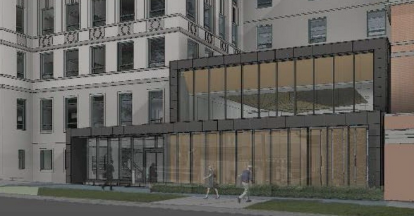
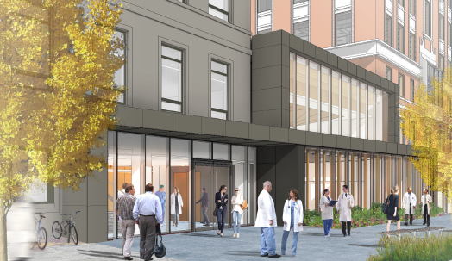
Clinical Science Building – 521 Parnassus Avenue
West Entrance – to auditorium
West Entrance – Ground Level

Slide 7
Clinical Sciences Building Amenities
Single occupancy Lactation room on Level 5 with card reader
Single occupancy Wellness Rooms on Levels 3 and 7
Shared Storage Rooms on Levels 2, 3, 4, 5 and 7 (4-5 compact file storage)
Shared Conference Rooms on Levels 2, 3, 4, 5, 6 (accommodates 12-14)
Shared Town Centers on Levels 2 thru 7 with card reader access
State of the art classrooms/multi-function rooms managed by Educational Technology Services on Ground Level and Level 1 via 25Live
Gender inclusive bathrooms on Levels 2, 4 and 6 with card reader access
Notes:
PM - Building was designed in 2013, prior to UCOP policy for Gender inclusive restrooms. We were able to incorporate a few on the upper floors, but were not able to add them to the ground floor or level 1

Slide 8
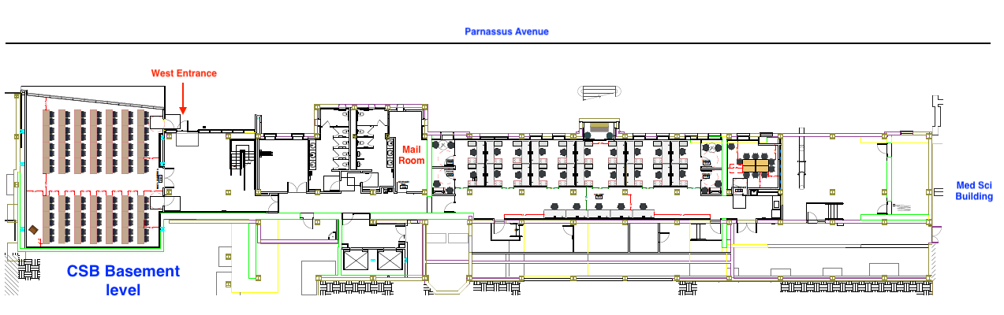
Clinical Sciences Building Ground Level
State of the art classrooms and multi-function rooms managed by Educational Technology Services on Ground Level and Level 1
Notes:
Mail Room – to be used by all departments. Will be locked and designated staff will have access. Inter campus mail, USPS and last mile deliveries will be here.
UPS/FedEx packages will be delivered to the floor with pre-arranged process.

Slide 9
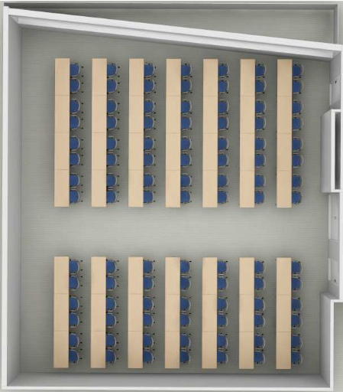
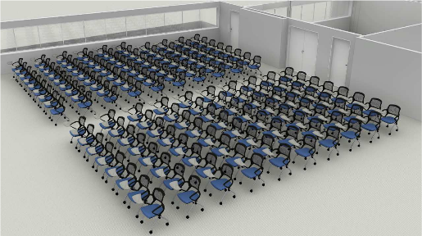
Clinical Science Building
Ground Level Auditorium
Auditorium style occupancy approx. 160
Classroom style occupancy approx. 98

Slide 10
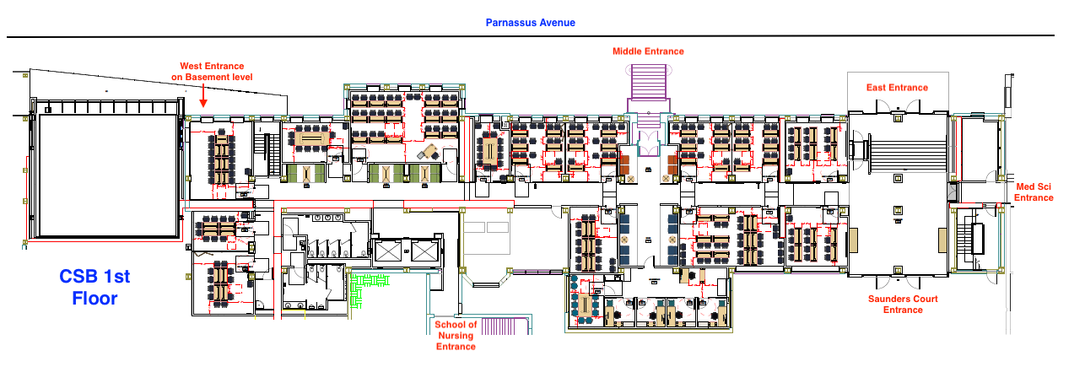
Clinical Science Building Level 1
Classrooms, Multi-Purpose Rooms and School of Medicine Admissions Office

Slide 11
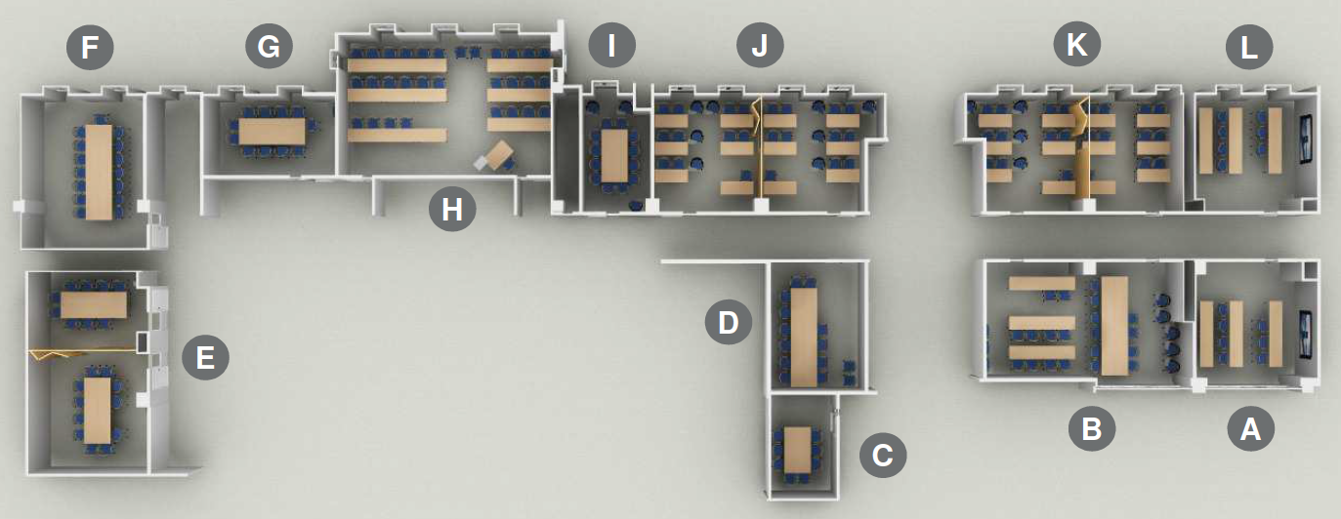
Clinical Science Building Level 1
Classrooms/Multi Purpose Rooms Managed by ETS on 25Live
14 Multipurpose rooms
4 can split into larger rooms (B, E, J & K)

Slide 12
Who is in the building?
UCSF Real Estate
Executive Vice Chancellor & Provost
School of Dentistry
School of Medicine
School of Pharmacy
School of Nursing
The Clinical Sciences Building, constructed in 1933, is one of the oldest buildings on the Parnassus Heights campus. The building is being renovated and retrofit to meet seismic safety requirements

Slide 13
Change Management Overview
What is Change Management?
  The purpose of change management is to realize the benefits and desired outcomes of change. It’s a framework for managing the people side of change.
  Organizational change requires individual change.
Open Plan at UCSF – a new way to work
Shared resources – storage, conference rooms, focus and huddle rooms, copy/print rooms, Town Centers/kitchen,
Building and Floor governance
Getting to know my floor & building colleagues

Slide 14
Change Agents – Who are they?
Inform
Inspire
Influence
Trusted department or division source of information
Lead by example and demonstrate desired behaviors
Identify types of resources needed to support staff and faculty on their team
Partners with Cristina Morrison, Leon Gardiner and other move team members throughout the process.
Engage with and inform department leadership throughout the process.
Engages with change agents on the floor and building to share best practices

Slide 15
Change Agents
Inform
Inspire
Influence
Executive Vice Chancellor & Provost: Suzanne Murphy, Winona Ward, Mae Moredo, Nina Mayo
School of Dentistry : Holly Ames, Brian Bast, Stephanie Louie, Marina Stewart
School of Nursing: David Rein
School of Pharmacy: Karen Hamblett, Michael Nordberg, Marley Quirante
School of Medicine
  Anesthesia: Robert Hendricks, Linda Liu
  Dean’s Office, Academy of Medical Educators: Allison Savage
  Dean’s Office, Admissions: Hallen Chung

Slide 16
Change Agents
Inform
Inspire
Influence
School of Medicine
  Dean’s Office: Pathways and Medical Education: Allison Savage
  Emergency Medicine: Christine Montgomery, Eve Dinh, Steve Polevoi
  Department of Medicine: Alyssa Tecklenburg
    Cardiology: Alyse Miluck
    Endocrinology: Tony Barlow, Umesh Mashrani
    Gastroenterology: Annamaria Flamburis
    Hospital Medicine: Annie Droste, Kathleen Li, Brad Sharpe
    Palliative Medicine: Angela Marks
    Pulmonary: Clarice Estrada, Dean Sheppard
    Rheumatology: Tony Barlow, Lindsey Criswell

Slide 17


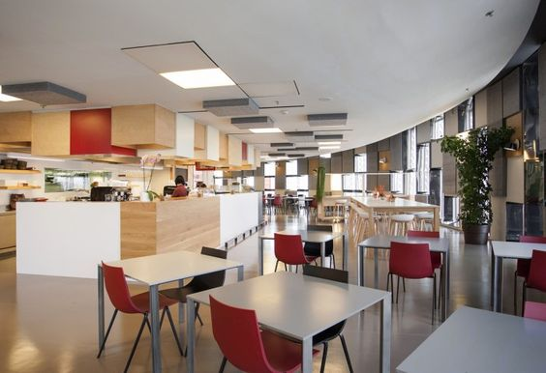
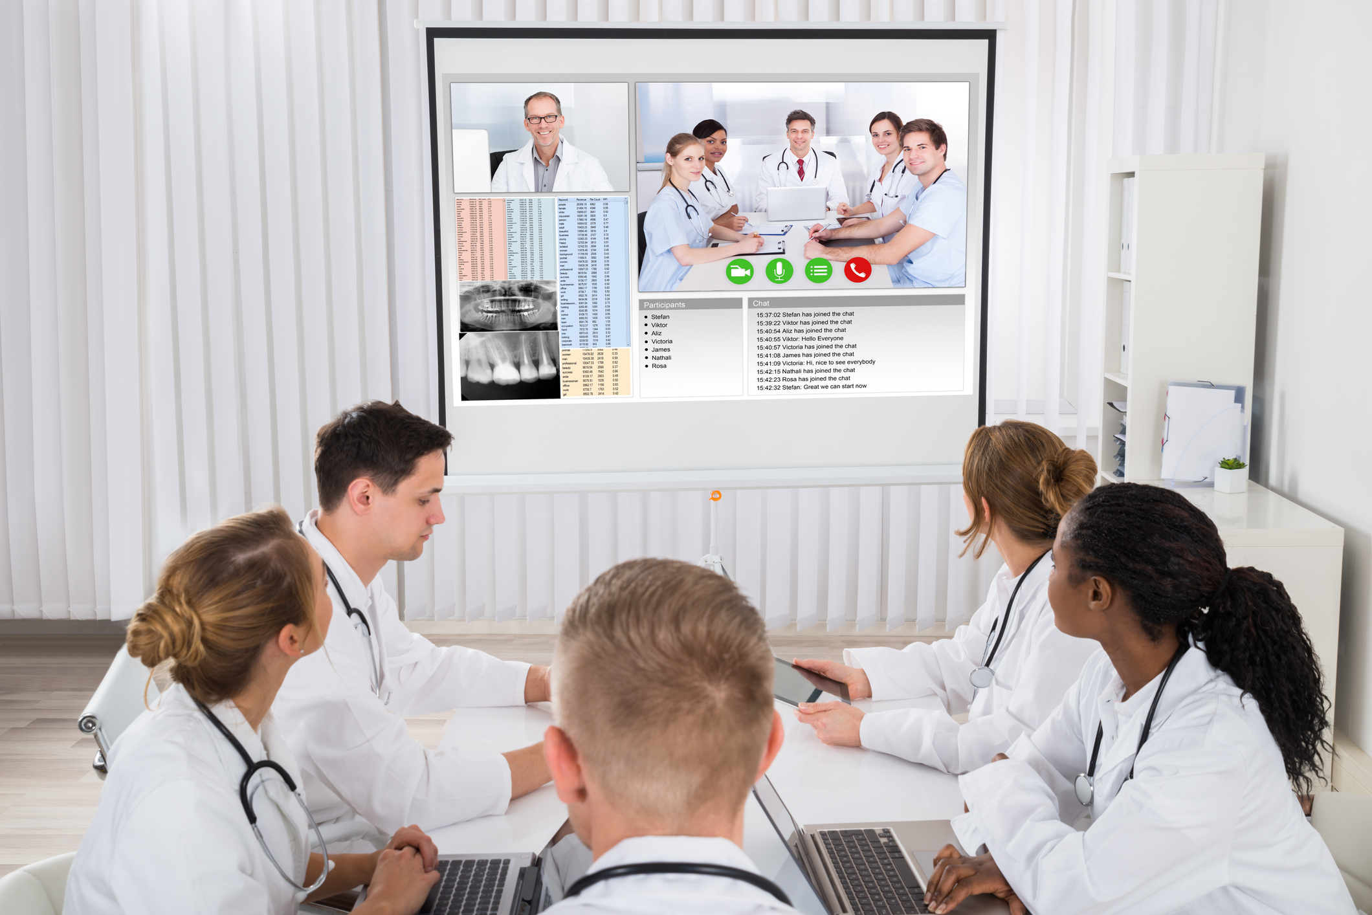
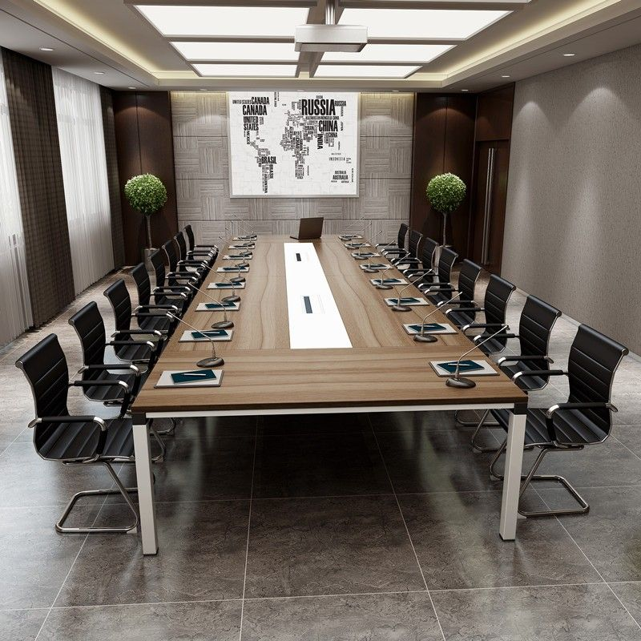
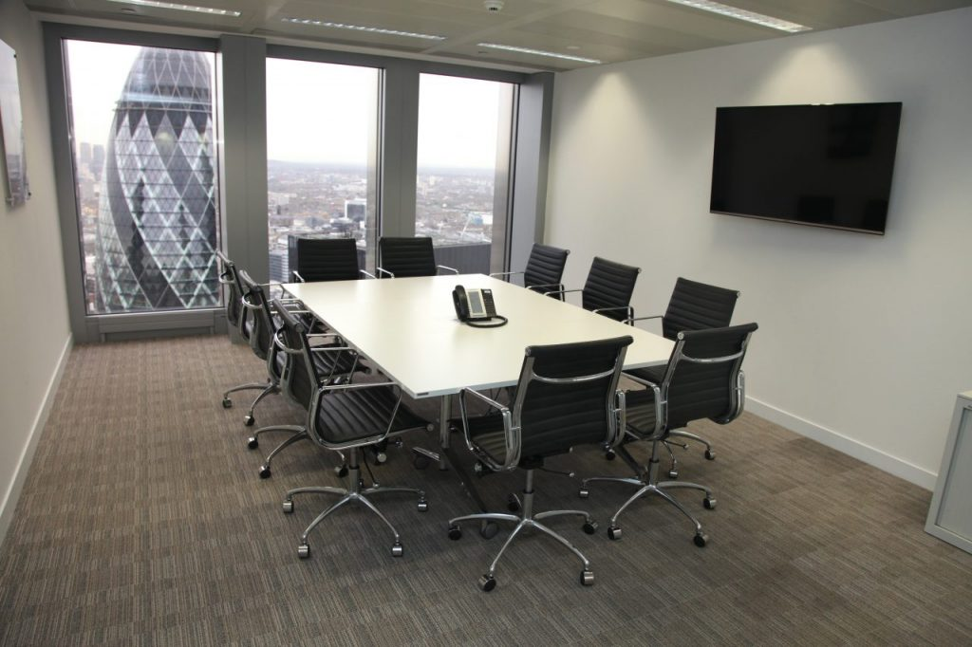
Open Plan at UCSF
Workstation
Private office
Focus room
Hotel Desk
Suitable for one person
Touch down space to use between meetings
Kitchen and break room
Huddle room
Conference rooms
Notes:
These images do not depict the actual space in the building. They provide a feeling of the space
work stations near the windows provide light for all.
Small private offices and focus rooms are meant for 1-2 people to work individually or in a small meeting.
Hotel desks throughout the floor are meant for visiting colleagues to have a touch-down space in between meetings.
Shared kitchen and break room, shared copy/printer rooms
Shared huddle rooms – groups of 4-6 people to collaborate.
Small conference rooms for 10-12 people.

Slide 18
Building and Floor Governance
Inform
Inspire
Influence
Building Governance Committee to be appointed by control point
  Dean’s Office level representation
Floor working group began work in January and will continue
through move in
Decisions for the building and floor committees to be made include:
  Conference room scheduling and access for all occupants
  Print Management for the building
  Shared resources (e.g. Floor Coordinator, shared space maintenance)
  Building security and access
Notes:
Coffee and tea service will be a shared cost for the floor TBD.
Floor and Building Governance will launch in February; decisions on security, access, and conference room scheduling will be decided for the building by occupant groups.

Slide 19
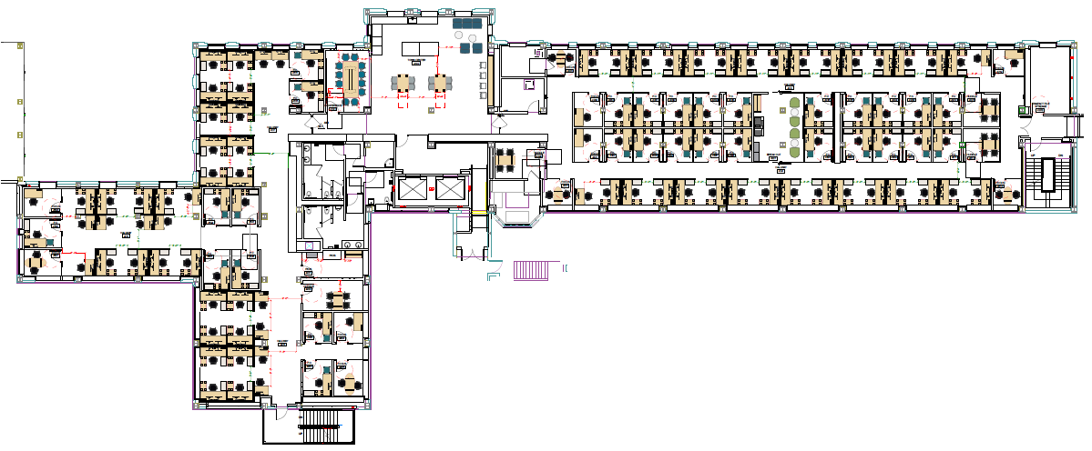
Typical Floor Plan Levels 2-5
Parnassus Avenue
Medical Sciences
Saunders Court
Digital Display
All desks are sit/stand
Approx. every other window will open
Elevators
Card reader locations – 3 entry points, locked 24/7

Slide 20
Shared Spaces by Floor
 | Focus | Huddle | Small Conference | Storage | Break-out & Printer | Printer
Floor 2 | 12 | 4 | 1 | 1 | 1 | 1
Floor 3 | 10 | 3 | 1 | 2 | 1 | 1
Floor 4 | 10 | 4 | 1 | 1 | 1 | 1
Floor 5 | 10 | 4 | 1 | 2 | 1 | 1
Floor 6 | 9 | 4 | 1 | 0 | 1 | 1
Floor 7 | 9 | 4 | 0 | 1 | 1 | 1

Slide 21

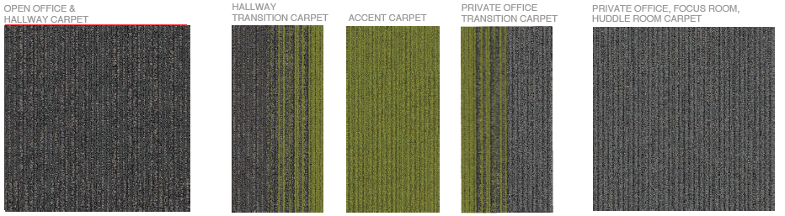
Clinical Science Building
Accent Color and Carpet
Green – Level 2 & 3 accent color
Orange – Level 4 & 5 accent color
Teal – Level 6 & 7 accent color
Notes:
Accent color will be in transition carpet, on a focus room wall, and on desk panel.

Slide 22
Floor Amenities
Inform
Inspire
Influence
Shared kitchens with microwaves, refrigerators, and filtered water
Shared conference rooms on Floors 2-6
ITS will provide the specs for technology in the rooms; training will be offered before and after move in
Storage will be shared by all building occupants
  Levels 4-5 have compact shelf storage
  Levels 2, 3, and 7 have storage rooms with file cabinets and storage cabinets
  Carolyn Tuft will work with Change Agents to distribute the needs across the building.

Slide 23
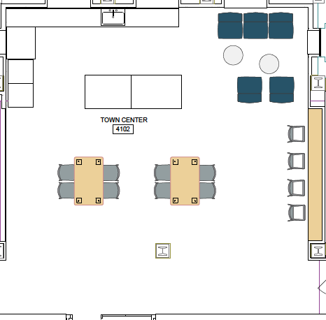
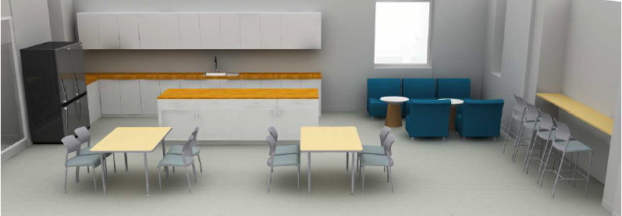
Shared Kitchen
Two refrigerators
Two microwaves
Dishwasher
Plumbed Coffee Maker

Slide 24
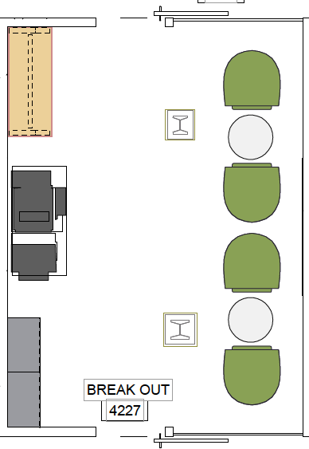
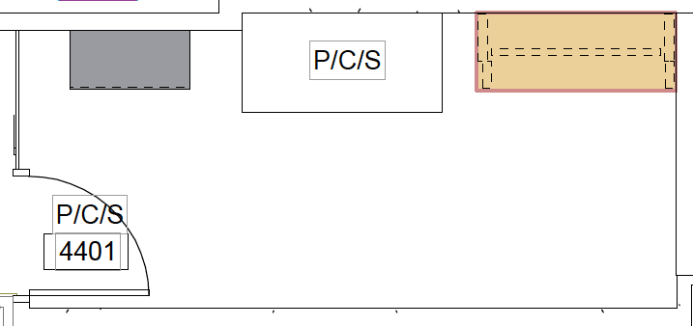
Multi-Function Device – Copier/Print Rooms
Two per floor
MFDs will be managed by Documents and Media
Fewer to no desktop printers

Slide 25
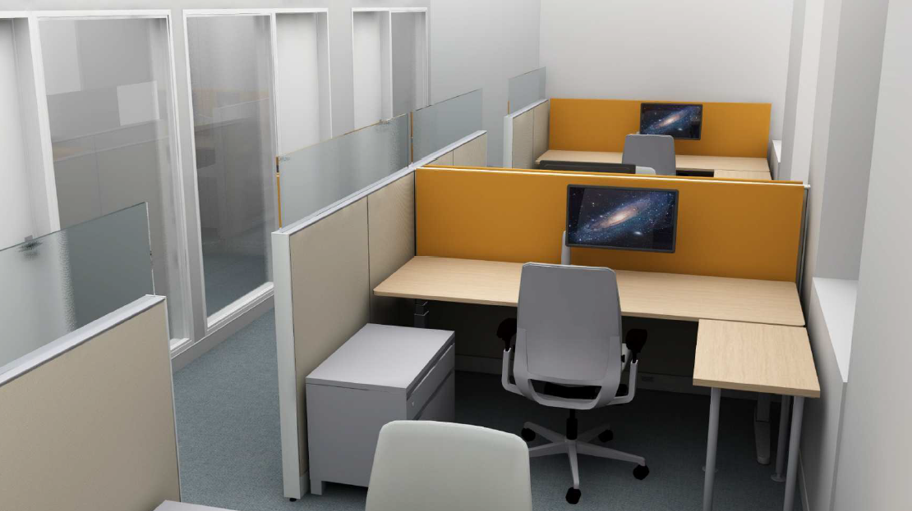
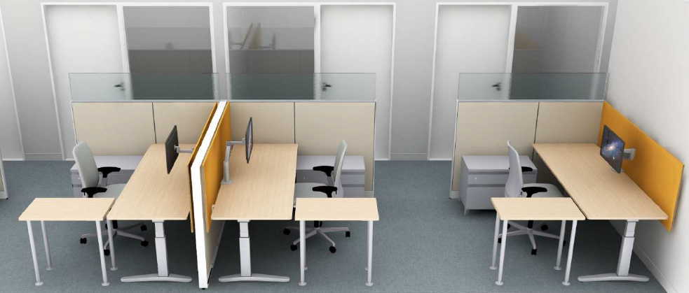
Standard Workstation
Solid partition 42” with 12” clear glass for total partition height 54”
Height adjustable desk 29”d x 82”w; with privacy panel.
Side table 18”d x 30”w
Low lockable storage unit 18”d x 30”w x 30”h
Ergonomic chair
Single monitor arm
Workstations include 4 power outlets and 2 data ports

Slide 26
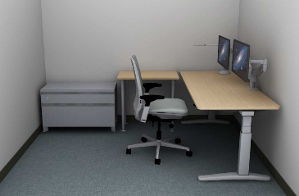
Typical Private Office Furnishings
Height adjustable desk 29”d x 70”w
Side table 18”d x 30”w
Low lockable storage unit 18”d x 30”w x 30”h
Ergonomic chair
Single monitor arm
Wood door and glass wall
Private Office Includes power outlets and 2 data ports

Slide 27

Document Management – Paper-Lite
Why change to a paper-lite workspace?
Use onsite space for people not paper
Support UCSF sustainability goals
Information is available whenever you need it, wherever you are

Slide 28
Document Management – UC RRS
Where can I find out how long to keep records?
UC Records Retention Schedule (UC RRS)
UC RRS Webinar
Administrative Records Relating to Research: Retention and Disposition Requirements
Record Retention Schedule Snapshot with most common record categories available to simplify determining how long to keep a record

Slide 29



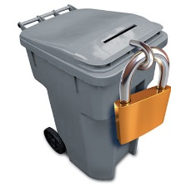
Document Management – Options
Scan
  In-house
  Vendor
Store
  Offsite Vendor
  Onsite (minimize volume)
Move to UCSF Archives
Dispose
  Shred
  Recycle
  Delete

Slide 30
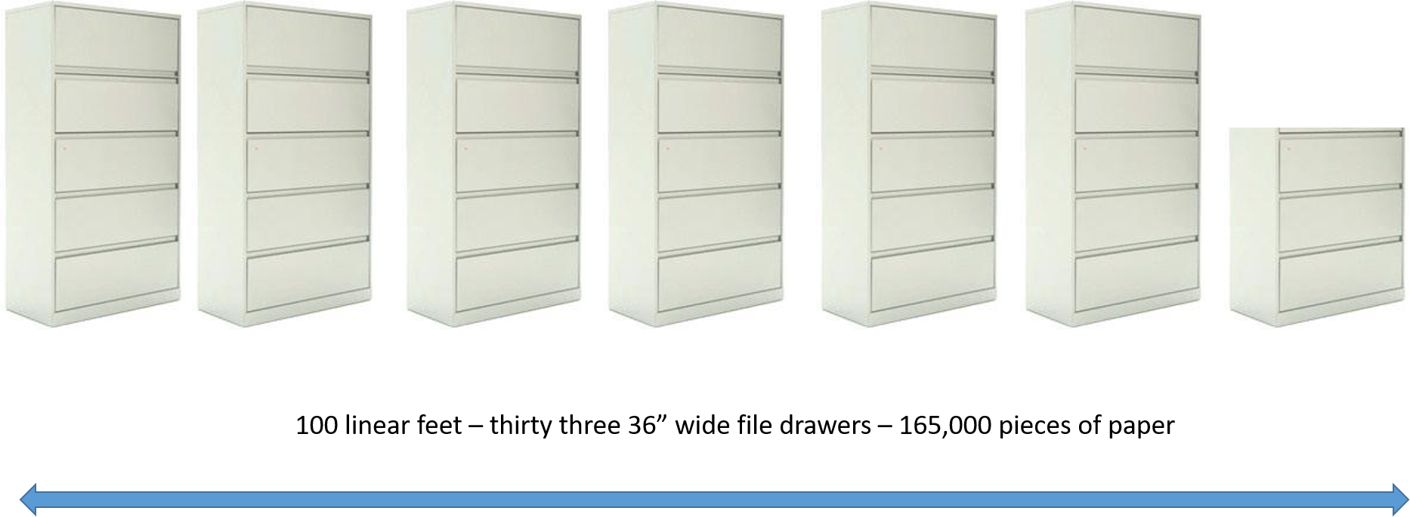
100 linear feet = 6.5 five drawer file cabinets!

Slide 31
Document Management – Act now
Change Agents and Managers are managing the process
Assess current state
  Do you have paper documents? Do you have kits or other materials that need storage?
Plan for processing paper and electronic records
  Plan for budget, staff time and tools
  Paper can be stored off-site, digitized (scanned) or shredded
  Review books and journals; be selective
Determine retention schedules and dispose appropriately
Review what is left and determine storage needs
Plan to complete by at least 60 days before your move date
Need assistance/ guidance? Contact your Change Agent and Carolyn.Tuft@ucsf.edu

Slide 32

Move Logistics: Pre-Planning Activities
Receive updated construction schedule
Develop rough move phase outline
Develop draft furniture installation schedule – by floor
Receive and evaluate move matrix for department and division head counts
Receive office storage plan for items moving to new building
Prepare move company bid documents and bid tour schedule

Slide 33

Move Logistics: Planning
Develop preliminary action items from move
meetings
Update move matrix for duration of planning stages
Develop individualized move meeting schedule and presentation content in concert with change agents
Create and distribute general move guide instructions
Create and distribute detailed logistic move schedule

Slide 34
Move Logistics: FAQ
How many days can I expect my department or
division to shut down for the move?
What items can I bring?
Is my phone moving with me?
Who is managing desktops, monitors and computer moves?
What about my laptop?
Once a move date is confirmed, how much time will I have to pack?
How many boxes can I bring to my new work space?

Slide 35
Frequently Asked Questions
How will noise be mitigated?
How will visitors find me?
Where can I find updates on the building and moving?
What about HIPAA compliance? UCSF Privacy Office and privacy handbook – review the handbook to ensure protected information is handled appropriately - https://ucsf.app.box.com/v/PrivacyHandbook2017
Remember to connect with your change agent for updates and support throughout the move process.

Slide 36
Resources and Information
Inform
Inspire
Influence
Clinical Sciences Building website: https://csb.ucsf.edu
Space website: https://space.ucsf.edu
Paper-Lite: https://space.ucsf.edu/records-information-management
UCSF Transportation website & my commute
Campus Life Services: Facilities Services Guide September 2017
*See high occupancy buildings on page 23

Slide 37
Wrap up & Next Steps
Inform
Inspire
Influence
Ongoing document management strategies – plan to have this effort complete by December 31, 2019
Department and Division move meetings
Building and Floor Governance decisions
Move Matrix
Ongoing updates on website, e-mail, e-newsletter
Thank You!

